Slide 1
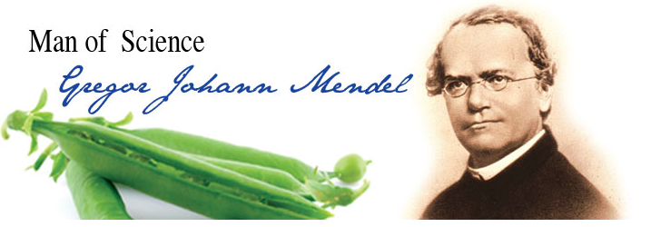
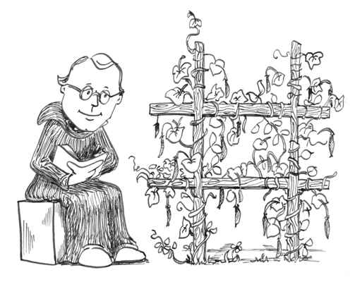
Genetics Notes
Who is Gregor Mendel?
Principle of Independent Assortment – Inheritance of one trait has no effect on the inheritance of another trait
“Father of Genetics”

Slide 2
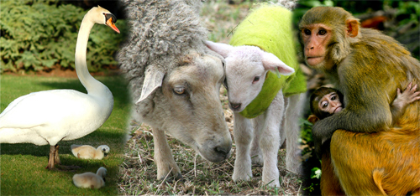
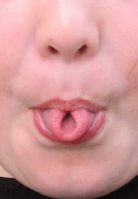
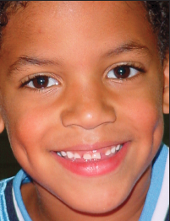
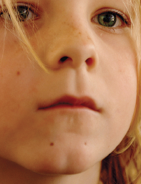
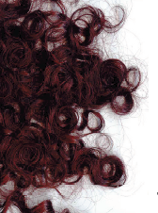
Traits
Genetics – study of how traits are passed from parent to offspring

Slide 3
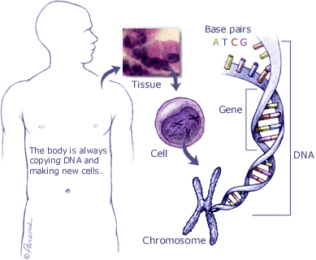
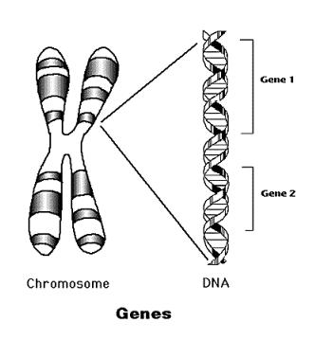
Traits are determined by the genes on the chromosomes. A gene is a segment of DNA that determines a trait.

Slide 4
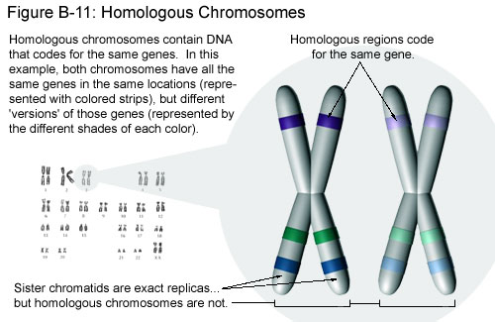
Chromosomes come in homologous pairs, thus genes come in pairs.
Homologous pairs – matching genes – one from female parent and one from male parent
Example: Humans have 46 chromosomes or 23 pairs.
One set from dad – 23 in sperm
One set from mom – 23 in egg

Slide 5

One pair of Homologous Chromosomes:
Gene for eye color (blue eyes)
Homologous pair of chromosomes
Gene for eye color (brown eyes)
Alleles – different genes (possibilities) for the same trait –
ex: blue eyes or brown eyes

Slide 6
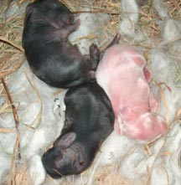
Dominant and Recessive Genes
Gene that prevents the other gene from “showing” – dominant
Gene that does NOT “show” even though it is present – recessive
Symbol – Dominant gene – upper case letter – T
Recessive gene – lower case letter – t
Recessive color
Dominant color

Slide 7
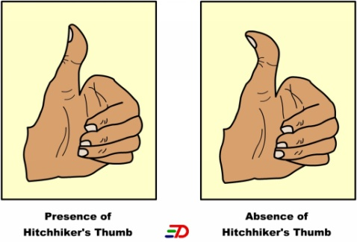
Example: Straight thumb is dominant to hitchhiker thumb T = straight thumb t = hitchhikers thumb
(Always use the same letter for the same alleles—
No S = straight, h = hitchhiker’s)
Straight thumb = TT
Straight thumb = Tt
Hitchhikers thumb = tt
* Must have 2 recessive alleles for a recessive trait to “show”

Slide 8
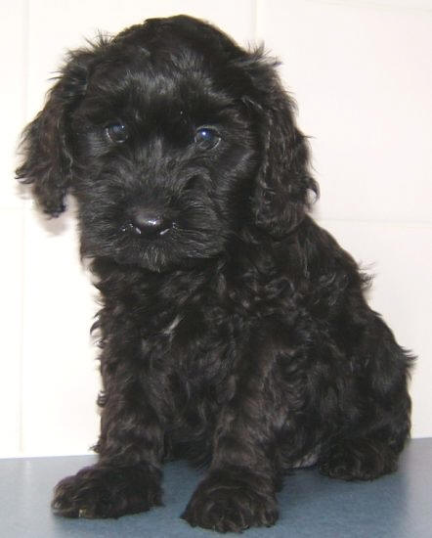
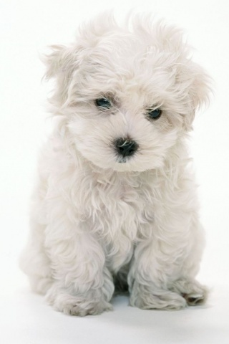
Both genes of a pair are the same –
homozygous or purebred
TT – homozygous dominant
tt – homozygous recessive
One dominant and one recessive gene – heterozygous or hybrid
Tt – heterozygous
BB – Black
Bb – Black w/ white gene
bb – White

Slide 9
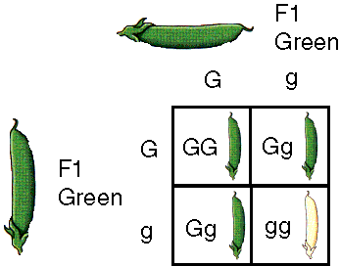
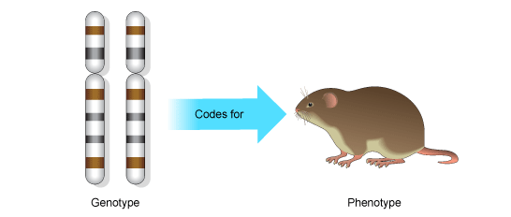
Genotype and Phenotype
Combination of genes an organism has (actual gene makeup) – genotype
Ex: TT, Tt, tt
Physical appearance resulting from gene make-up – phenotype
Ex: hitchhiker’s thumb or straight thumb

Slide 10
Punnett Square and Probability
Used to predict the possible gene makeup of offspring – Punnett Square
Example: Black fur (B) is dominant to white fur (b) in mice
Cross a heterozygous male with a homozygous recessive female.
Black fur (B)
White fur (b)
Heterozygous
male
Homozygous recessive female
White fur (b)
White fur (b)

Slide 11
Male = Bb X Female = bb
Female gametes – N
(One gene in egg)
b
b
Bb | Bb
bb | bb
Possible offspring – 2N
B
Male gametes - N
(One gene in sperm)
b
Write the ratios in the following orders:
Genotypic ratio
homozygous : heterozygous : homozygous
dominant recessive
Phenotypic ratio
dominant : recessive
Genotypic ratio = 2 Bb : 2 bb
50% Bb : 50% bb
Phenotypic ratio = 2 black : 2 white
50% black : 50% white

Slide 12
Cross 2 hybrid mice and give the genotypic ratio and phenotypic ratio.
Bb X Bb
B
b
BB | Bb
Bb | bb
B
b
Genotypic ratio = 1 BB : 2 Bb : 1 bb
25% BB : 50% Bb : 25% bb
Phenotypic ratio = 3 black : 1 white
75% black : 25% white

Slide 13
Example: A man and woman, both with brown eyes (B) marry and have a blue eyed (b) child. What are the genotypes of the man, woman and child?
Bb X Bb
Man = Bb
Woman = Bb
B
b
BB | Bb
Bb | bb
B
b

Slide 14
Crossing involving 2 traits – Dihybrid crosses
Example: In rabbits black coat (B) is dominant over brown (b) and straight hair (H) is dominant to curly (h). Cross 2 hybrid rabbits and give the phenotypic ratio for the first generation of offspring.
Possible gametes:
BbHh X BbHh
BH BH
Bh Bh
bH bH
bh bh
Gametes
BH
Bh
bH
bh
BBHH | BBHh | BbHH | BbHh
BBHh | BBhh | BbHh | Bbhh
BbHH | BbHh | bbHH | bbHh
BbHh | Bbhh | bbHh | bbhh
BH
Phenotypes - 9:3:3:1
Bh
9 black and straight
3 black and curly
bH
3 brown and straight
1 brown and curly
bh

Slide 15
Example: In rabbits black coat (B) is dominant over brown (b) and straight hair (H) is dominant to curly (h). Cross a rabbit that is homozygous dominant for both traits with a rabbit that is homozygous dominant for black coat and heterozygous for straight hair. Then give the phenotypic ratio for the first generation of offspring.
BBHH X BBHh
Possible gametes: BH BH
Bh
BH
Bh
Gametes
Phenotypes:
BBHH | BBHh
BH
100% black and straight
Gametes
(Hint: Only design Punnett squares to suit the number of possible gametes.)

Slide 16
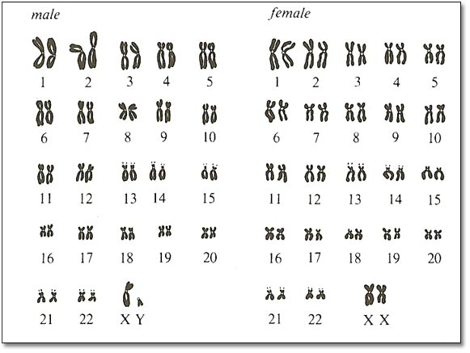
Sex Determination
People – 46 chromosomes or 23 pairs
22 pairs are homologous (look alike) – called autosomes – determine body traits
1 pair is the sex chromosomes – determines sex (male or female)
Females – sex chromosomes are homologous (look alike) – label XX
Males – sex chromosomes are different – label XY

Slide 17
What is the probability of a couple having a boy? Or a girl?
Chance of having female baby? 50%
male baby? 50%
X
X
XX | XX
XY | XY
X
Y
Who determines the sex of the child? father

Slide 18
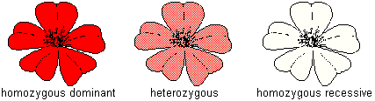
Incomplete dominance and Codominance
When one allele is NOT completely dominant over another (they blend) – incomplete dominance
Example: In carnations the color red (R) is incompletely dominant over white (W). The hybrid color is
pink. Give the genotypic and phenotypic ratio from a cross between 2 pink flowers.
RW X RW
R
W
R
RR | RW
RW | WW
W
Genotypic = 1 RR : 2 RW : 1 WW
Phenotypic = 1 red : 2 pink : 1 white

Slide 19
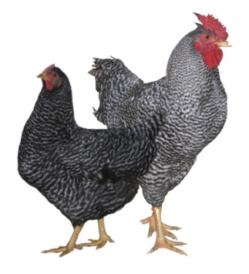
When both alleles are expressed – Codominance
Example: In certain chickens black feathers are codominant with white feathers.
Heterozygous chickens have black and white speckled feathers.

Slide 20
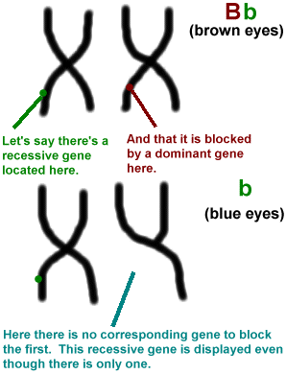
Sex – linked Traits
Genes for these traits are located only on the X chromosome (NOT on the Y chromosome)
X linked alleles always show up in males whether dominant or recessive because males have only one X chromosome

Slide 21
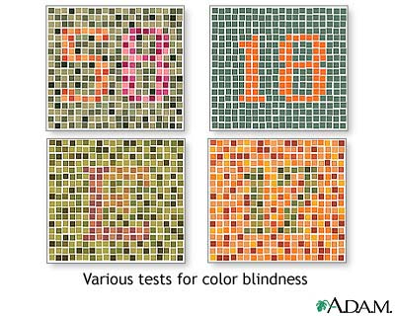
Examples of recessive sex-linked disorders:
colorblindness – inability to distinguish between certain colors
You should see 58 (upper left), 18 (upper right), E (lower left) and 17 (lower right).
Color blindness is the inability to distinguish the differences between certain colors. The most common type is red-green color blindness, where red and green are seen as the same color.

Slide 22
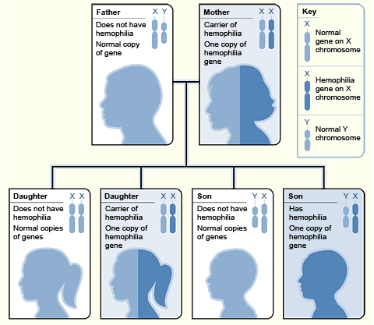
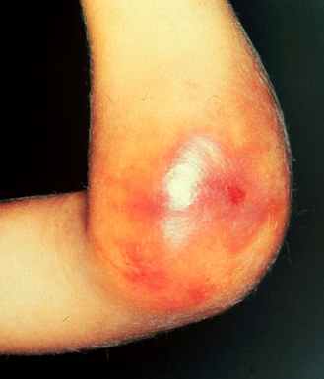
2. hemophilia – blood won’t clot

Slide 23
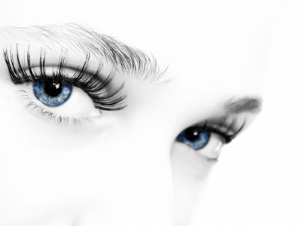
Example: A female that has normal vision but is a carrier for colorblindness marries a male with normal vision. Give the expected phenotypes of their children.
N = normal vision
n = colorblindness X^{N} X^{n} X X^{N} Y
X^{N}
X^{n}
X^{N}X^{N} | X^{N}X^{n}
X^{N}Y | X^{n}Y
X^{N}
Y
Phenotype: 2 normal vision females
1 normal vision male
1 colorblind male

Slide 24
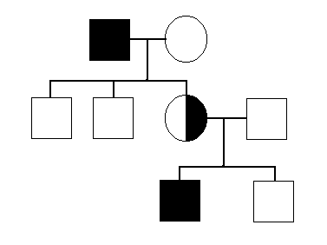
Pedigrees
Graphic representation of how a trait is passed from parents to offspring
Tips for making a pedigree
Circles are for females
Squares are for males
Horizontal lines connecting a male and a female represent a marriage
Vertical line and brackets connect parent to offspring
A shaded circle or square indicates a person has the trait
A circle or square NOT shaded represents an individual who does NOT have the trait
Partial shade indicates a carrier – someone who is heterozygous for the trait

Slide 25
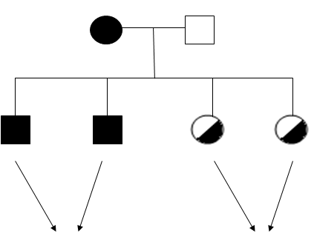
Example: Make a pedigree chart for the following couple. Dana is color blind; her husband Jeff is not.
They have two boys and two girls.
HINT: Colorblindness is a recessive sex-linked trait.
X^{n}X^{n}
X^{N}Y
Has trait
Can pass trait to offspring

Slide 26
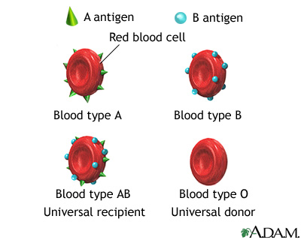
Multiple Alleles
3 or more alleles of the same gene that code for a single trait
In humans, blood type is determined by 3 alleles – A, B, and O
BUT each human can only inherit 2 alleles
Dominant – A and B (codominance)
Recessive – O
2. Blood type – A = AA or AO
B = BB or BO
AB = AB
O = OO

Slide 27
Example: What would be the possible blood types of children born to a female with type AB blood and
a male with type O blood?
AB X OO
A
B
O
AO | BO
AO | BO
O
Children would be type A or B only

Slide 28
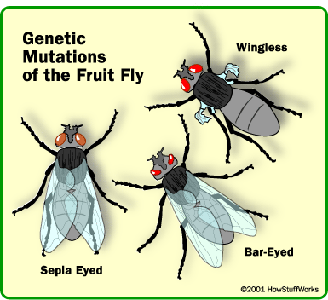
Mutations
Mutation – sudden genetic change (change in base pair sequence of DNA)
Can be :
Harmful mutations – organism less able to survive: genetic disorders, cancer, death
Beneficial mutations – allows organism to better survive: provides genetic variation
Neutral mutations – neither harmful nor helpful to organism
Mutations can occur in 2 ways: chromosomal mutation or gene/point mutation

Slide 29
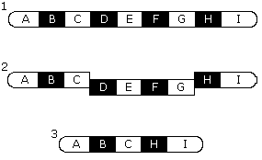
Chromosomal mutation:
less common than a gene mutation
more drastic – affects entire chromosome, so affects many genes rather than just one
caused by failure of the homologous chromosomes to separate normally during meiosis
chromosome pairs no longer look the same – too few or too many genes, different shape

Slide 30
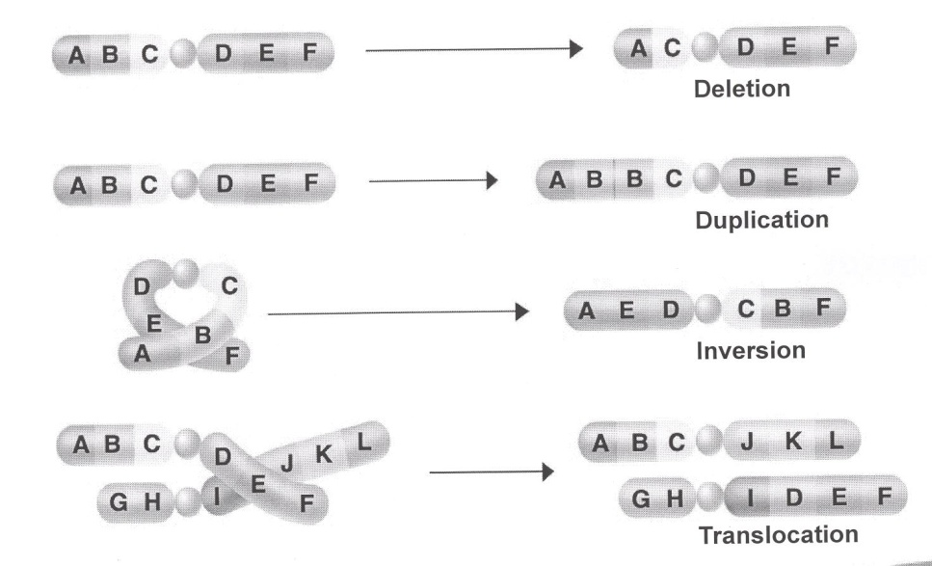

Slide 31
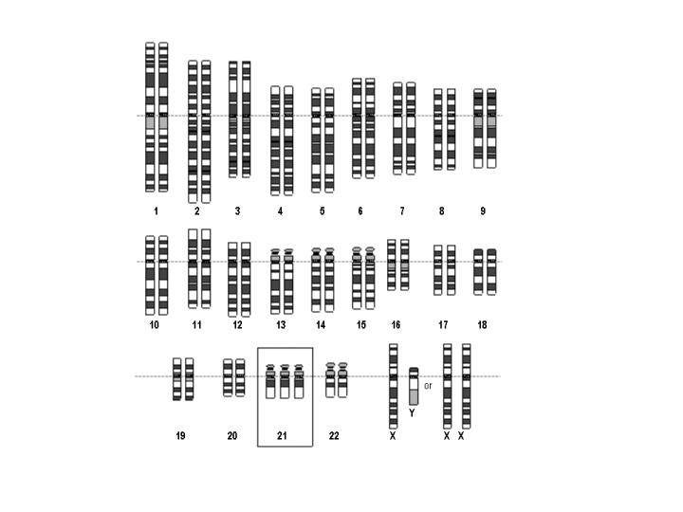
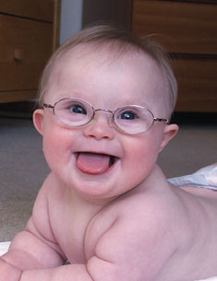
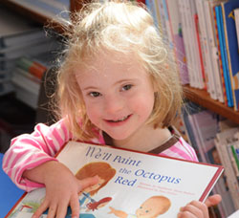


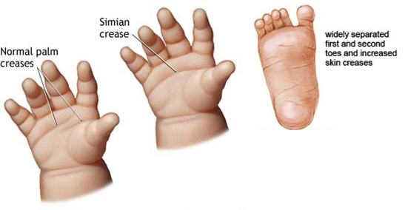
Examples:
Down’s syndrome – (Trisomy 21) 47 chromosomes, extra chromosome at pair #21

Slide 32
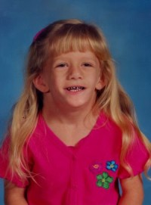
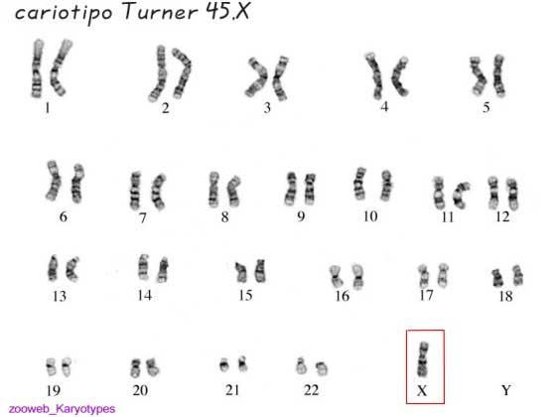
Turner’s syndrome – only 45 chromosomes, missing a sex chromosome (X)
Girls affected – short, slow growth, heart problems

Slide 33
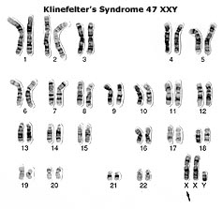
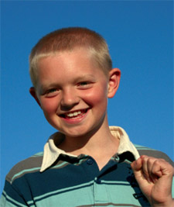

Klinefelter’s syndrome – 47 chromosomes, extra X chromosomes (XXY)
Boys affected – low testosterone levels, underdeveloped muscles, sparse facial hair

Slide 34
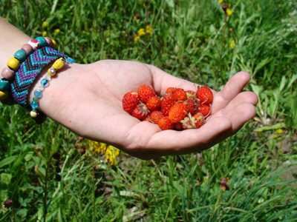
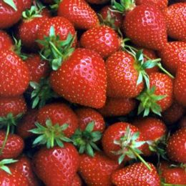
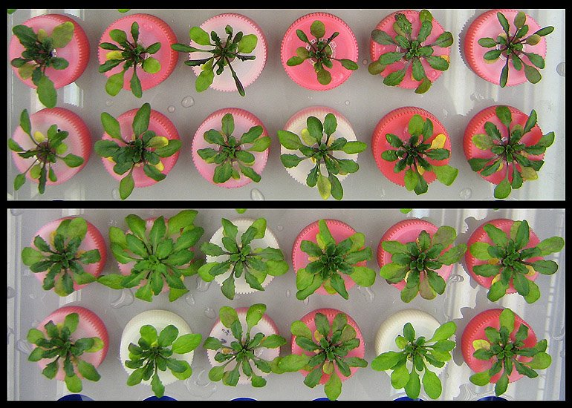
Having an extra set of chromosomes is fatal in animals, but in plants it makes them larger and hardier.
Hardier

Slide 35
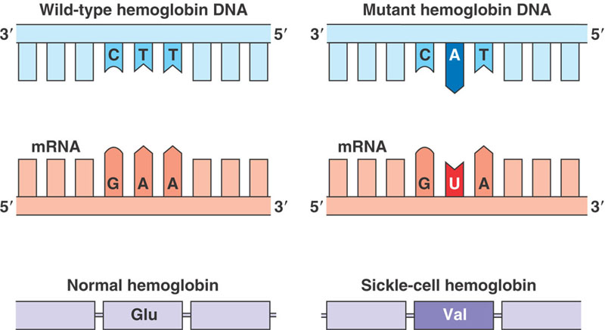
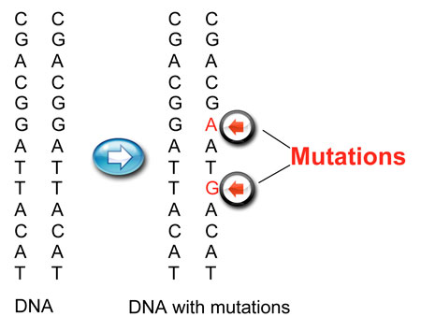
Gene or Point Mutation
most common and least drastic
only one gene is altered

Slide 36
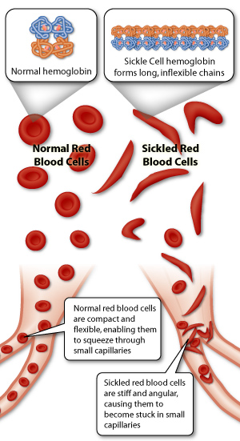
Examples:
Recessive gene mutations:
Sickle cell anemia – red blood cells are sickle shaped instead of round and cannot carry enough oxygen to the body tissues – heterozygous condition protects people from malaria

Slide 37
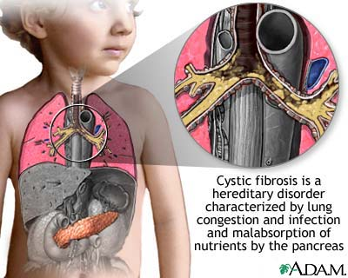
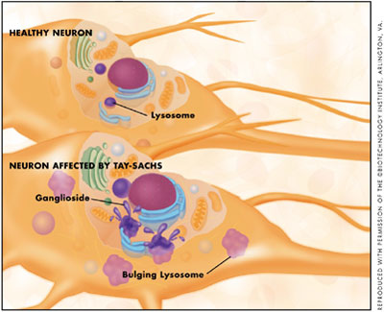
Cystic fibrosis – mucous builds up in the lungs
Tay-Sachs Disease – deterioration of the nervous system – early death
Mutated genes produce enzymes that are less effective than normal at breaking down fatty cell products known as gangliosides. As a result, gangliosides build up in the lysosomes and overload cells. Their buildup ultimately causes damage to nerve cells.

Slide 38
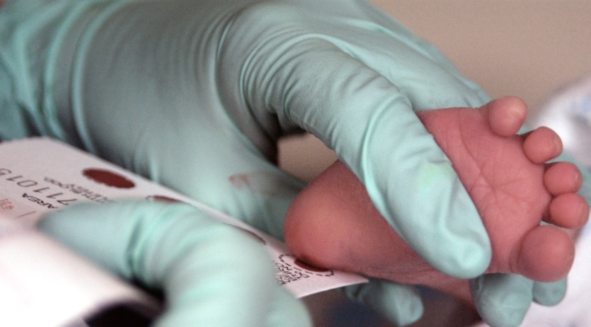
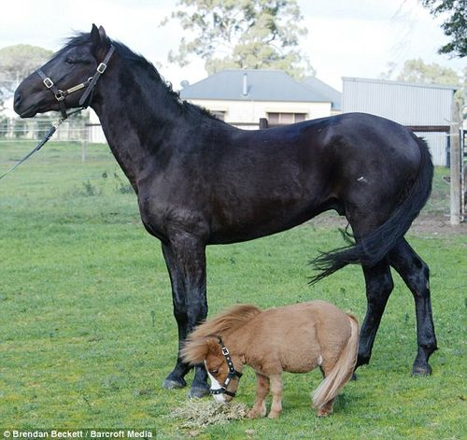
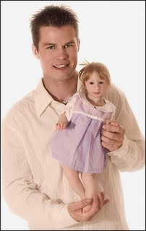
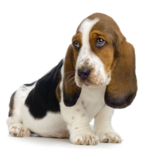
Phenylketonuria (PKU) – an amino acid common in milk cannot be broken down and as it builds up it causes mental retardation – newborns are tested for this
Dominant gene mutations:
Huntington’s disease – gradual deterioration of brain tissue, shows up in middle age and is fatal
Dwarfism – variety of skeletal abnormalities

Slide 39
Detecting Genetic Disorders
picture of an individual’s chromosomes – karyotype
amniotic fluid surrounding the embryo is removed for analysis – amniocentesis
Female with Down’s syndrome

